Slide 1
Apologetics
Book 1
Introduction
&
Bible Inspiration

Slide 2
Purpose of Class
Increase the faith of students
  By establishing the validity of the Bible
  Refuting typical arguments of skeptics
Topics to be covered will include:
  Bible inspiration (Historical, geographical & factual accuracy; Scientific foreknowledge; Fulfilled prophecy; Literary uniformity)
  The existence of God & Deity of Christ
  Creation Evidences (contrasted with Evolution)
  How we got the Bible
  Contrasting Christianity with other world religions
  Alleged Biblical discrepancies and errors
Notes:
Note: Under “Topics to be covered”
Probably 6 different books. (More will be known later)
Inspiration of the Bible
The Existence of God and the Deity of Jesus Christ
Creation/Evolution
How We Got the Bible (Textual Criticism)
Contrast of Christianity with other world religions
Alleged Discrepencies (Skeptics Arguments)

Slide 3
Methodology of Class
Series of booklets (six)
  Outline of material that we will cover (will be covered in more detail in class, with use of presentations).
  Supplementary articles (most from Apologetics Press website, used with permission) with discussion questions appended to articles.
Students are encouraged:
  To read material, including ALL scripture references.
  Ask questions regarding any material that is either unclear or not understood.

Slide 4
Apologetics (Definition)
1: systematic argumentative discourse in defense (as of a doctrine). 2: a branch of theology devoted to the defense of the divine origin and authority of Christianity
Merriam-Webster online dictionary
Notes:
Greek term “apologia” (a plea (“apology”): - answer (for self), clearing of self, defence.) Strong’s
Acts 22:1; Acts 25:16; 2 Cor. 7:11; Phi. 1:7, Phi. 1:17; 2 Tim. 4:16; 1 Pet. 3:15 (translated: answer, defense, clearing of yourselves)

Slide 5
We are a people of Faith
Now faith is the substance of things hoped for, the evidence of things not seen. ² for by it the elders obtained a good testimony. ³ by faith we understand that the worlds were framed by the word of God, so that the things which are seen were not made of things which are visible.
(Hebrews 11:1-3)
Notes:
Idea that all who enter a church building must leave “reason at the door”, though true with some religion, and with some who practice a distorted view of the Christian faith (for example, Gnostics), is not substantively true at all!
Hebrews 11 is not a definition (It notes the relationship between what we can see, and what we can not see).
Faith is a bridge between what we know by experience, and what is not knowable by experience. (Atheist has same problem)
Consider: The atheist is not omniscient, nor omnipresent… and yet he sincerely believes that there is no God. That is a type of faith.
Faith has a rational foundation. For example, faith in the existence of God. (Teleological argument)
(Psalm 19:1-4), “The heavens declare the glory of God; And the firmament shows His handiwork. ² Day unto day utters speech, And night unto night reveals knowledge. ³ There is no speech nor language Where their voice is not heard. ⁴ Their line^{[a]} has gone out through all the earth, And their words to the end of the world.”

Slide 6
Fred Hoyle
Would you not say to yourself, “Some super-calculating intellect must have designed the properties of the carbon atom, otherwise the chance of my finding such an atom through the blind forces of nature would be utterly minuscule.” Of course you would… A common sense interpretation of the facts suggests that a superintellect has monkeyed with physics, as well as with chemistry and biology, and that there are no blind forces worth speaking about in nature. The numbers one calculates from the facts seem to me so overwhelming as to put this conclusion almost beyond question.
Fred Hoyle, Engineering and Science, The Universe: Past and Present Reflections
Notes:
Fred Hoyle (Quote from 1981) Noted British Astronomer (1915 – 2001)
Cambridge Institute of Astronomy
Science Fiction writer
Formulated the respected Theory of Stellar Nucleosynthesis (explaining how stars work (reaction characteristics)

Slide 7
Antony Flew
Antony Flew, who spent most of his life as an atheist, converted to deism late in life, and postulated "an intelligent being as involved in some way in the design of conditions that would allow life to arise and evolve." He concluded that the fine-tuning of the universe was too precise to be the result of chance, so accepted the existence of God. He said that his commitment to "go where the evidence leads" meant that he ended up accepting the existence of God. Flew proposed the view, held earlier by Fred Hoyle, that the universe is too young for life to have developed purely by chance and that, therefore, an intelligent being must exist which was involved in designing the conditions required for life to evolve.
Wikipedia entry on Teleological Argument
Notes:
Antony Flew (1923 – 2010)
English philosopher and one time avowed atheist (a signer of the Humanist Manifesto in 2003). His changed view was made known in 2004.
Interestingly, in late 2006, Flew joined 11 other academics in urging the British government to teach intelligent design in the state schools.
Return to Outline: (Paul’s teleological argument in Acts 17:29-31) Read
Note: The assurance was a miraculous event. (Jesus resurrection from the dead). We will examine this in the future…
Psalm 14:1, “The fool has said in his heart, “There is no God.” They are corrupt, They have done abominable works, There is none who does good.”
The atheist denies the teleological evidence of a divine creator. He seeks an explanation other than the obvious.
Motivation for disbelief – There is no Being to whom we owe allegiance or obedience.
Job 38-41 (Verses where God claims to be the first cause, and creator of all). (Note evidence, but claim… our view).
Romans 1:18-32, Read (The teleological argument stated, with consequences of unbelief)

Slide 8
Fine Tuned Universe
Fine-tuning refers to the surprising precision of nature’s physical constants and the beginning state of the universe. Both of these features converge as potential pointers to a Creator. To explain the present state of the universe, scientific theories require that the physical constants of nature — like the strength of gravity — and the beginning state of the Universe — like its density — have extremely precise values. The slightest variation from their actual values results in an early universe that never becomes capable of hosting life. For this reason, the universe seems finely-tuned for life.
http://biologos.org/questions/fine-tuning
Notes:
Fine Tuning:
The universe exists exactly how it must exist to be a stable cosmos.
The solar system exists exactly how it exists to be a stable system.
The earth exists as it exists (distance from sun and moon, atmospheric makeup, etc.) to be able to sustain life
Note: The following is also identified as the “anthropic principle”
Freeman John Dyson FRS is an English-born American theoretical physicist and mathematician, famous for his work in quantum electrodynamics, solid-state physics, astronomy and nuclear engineering, wrote: "The more I examine the universe, and the details of its architecture, the more evidence I find that the Universe in some sense must have known we were coming.“ (Disturbing the Universe. New York: Harper and Row, 1979).

Slide 9
Fine Tuned Universe
If John wins a 1-in-1,000,000,000 lottery game, you would not immediately be tempted to think that John (or someone acting on his behalf) cheated. If, however, John won three consecutive 1-in-1,000 lotteries, you would immediately be tempted to think that John (or someone acting on his behalf) cheated. Schlesinger believes that the intuitive reaction to these two scenarios is epistemically justified. The structure of the latter event is such that it… justifies a belief that intelligent design is the cause… Despite the fact that the probability of winning three consecutive 1-in-1,000 games is exactly the same as the probability of winning one 1-in-1,000,000,000 game, the former event… warrants an inference of intelligent design.
Notes:
Argument made by George Schlesinger (Professor of Philosophy, University of North Carolina)
(Taken from Teleological argument entry on Wikipedia)

Slide 10
Kenneth Himma’s Objection
“The mere fact that it is enormously improbable that an event occurred... by itself, gives us no reason to think that it occurred by design… As intuitively tempting as it may be...”
Himma contends two things necessary to make such an inference:
We must know that outside, intelligence agents exist.
We must have past experience that suggests the events are usually caused by such intelligent outside agents.
Notes:
Initial quote: Himma, Kenneth Einar (12 April 2009). "Design Arguments for the Existence of God". Internet Encyclopedia of Philosophy. Retrieved November 19, 2011.
Problems with Himma’s “requirements.”
Deny the capability of man to infer beyond direct experience. Something man has shown himself capable of commonly. (Intuition, creativity, etc.)
Deny that man HAS had past experience with the Almighty. In fact, Paul’s argument from Acts 17:30-31, “Truly, these times of ignorance God overlooked, but now commands all men everywhere to repent, ³¹ because He has appointed a day on which He will judge the world in righteousness by the Man whom He has ordained. He has given assurance of this to all by raising Him from the dead.”
It is “chronological snobbery” (C.S. Lewis) to dismiss out of hand the accounts of men in the past describing their interactions with God.

Slide 11
We must defend our faith
But sanctify the Lord God in your hearts, and always be ready to give a defense to everyone who asks you a reason for the hope that is in you, with meekness and fear.
(1 Peter 3:15)
Notes:
Purpose of this material is to allow us to give a defense of our faith to the skeptic
Other purpose: Will strengthen our faith
By its nature, can’t be exhaustive, but I believe it will be representative
Note: Some of the things we will discuss will hold more merit to the believer than the unbeliever (faith strengthening). Overall, the material, I believe, will be able to convince the open minded individual.
(Jude 3-4), Beloved, while I was very diligent to write to you concerning our common salvation, I found it necessary to write to you exhorting you to contend earnestly for the faith which was once for all delivered to the saints. ⁴ For certain men have crept in unnoticed, who long ago were marked out for this condemnation, ungodly men, who turn the grace of our God into lewdness and deny the only Lord God^{[b]} and our Lord Jesus Christ.

Slide 12
The term, apologia used by Paul
“Brethren and fathers, hear my defense before you now” (Acts 22:1).
“My defense to those who examine me is this: ⁴ Do we have no right to eat and drink? ⁵ Do we have no right to take along a believing wife, as do also the other apostles, the brothers of the Lord, and Cephas?” (1 Corinthians 9:3-5)
Notes:
Acts 22:1 (Defense of himself after arrest in Jerusalem. Speaking to a mob of fellow Jews)
1 Corinthians 9:3-5 (Defense of himself as an apostle and worthy of material support in his work)
Romans 1:20, “ For since the creation of the world His invisible attributes are clearly seen, being understood by the things that are made, even His eternal power and Godhead, so that they are without excuse.” (The teleological argument we referred to earlier)
Acts 17:22-31 (Paul’s sermon on Mars Hill)
Apologetic discourse, but to pagans, not atheists
He was not trying to convince them of the concept of God, but that His God was the true One.
Apologetics contains more than arguments to convince the scientific skeptic. Also the philosophical, or religious skeptic.

Slide 13
The Christian Faith is Objective
Historical and factual! (Luke 2:1-5; 3:1-2)
Christ as object (1 Corinthians 15:1-4)
Note: Consequence of denying the faith (John 8:24)
It is based on truth! (Acts 2:22-24; 26:24-26)
Notes:
(Luke 2:1-5) Luke carefully describes the circumstances surrounding Jesus’ birth
The events, geography and names are verifiable
(Luke 3:1-2) Luke does the same thing re: those in power when John the Baptist began ministry
To deny the faith has consequences!
(John 8:24), “Therefore I said to you that you will die in your sins; for if you do not believe that I am He, you will die in your sins.”
These words said by Jesus to unbelieving Jews as He revealed his eventual death.
The ultimate truth we will affirm, and prove to be tenable and reasonable. The death, burial and resurrection of Jesus Christ
(Acts 2:22-24) Peter’s affirmation of such on the day of Pentecost
(Acts 26:24-26) Paul to Festus, “This thing was not done in a corner.” (Agrippa knew of resurrection)

Slide 14
Conclusion
Faith bridges the gap between evidence and certainty (BTW, the atheist, evolutionist and skeptic are in the same boat).
The purpose of a study of apologetics is to provide reasonable proofs as to the truthfulness of all those things that relate to the Christian faith.
  Equip the Christian to deal with the skeptic.
  Answer honest questions about our faith.

Slide 15
Disc. Q: What Is Apologetics?
What tools do you feel you need to be further equipped with, to help in your defense of truth?
Why do you think the secular world considers Christians to be unreasonable and superstitious?
Is it logical or reasonable to deny the inspiration of scripture, and the claims it contains, and still consider the Bible to be valuable or helpful?
Is a pursuit of verifiable truth reasonable? Attainable? Relevant to our needs and time?
Notes:
My purpose in this is to help get an idea of how to further develop the series. Is there any area of Christian evidences where you feel yourself inadequate? As we have indicated (page 4) areas we will cover, is there anything not there you would like included?
Some possibilities: a) Denominational acrimony, based on contradictory teaching. (cf. John 17:20-21); b) Inclusion in scripture of demons, miracles, God’s direct intervention in the affairs of men.
Yes, chicken soup for the soul, BUT (if not inspired) a BOOK OF LIES! (cf. 1 Corinthians 15:19).
Reasonable? (cf. Hebrews 11:6, can’t please God w/out faith). Attainable? (cf. John 8:21, you shall know the truth). Relevant? (Yes, if it is divine truth!) Also, note that the character of man has not changed.

Slide 16
The Inspiration of the Bible
Last eve I passed beside a blacksmith’s door,
And heard the anvil ring the vesper chime;
Then looking, I saw upon the floor,
Old hammers, worn with beating years of time
“How many anvils have you had,” said I,
“To wear and batter all these hammers so?”
“Just one,” said he, and then with twinkling eye;
“The anvil wears the hammers out, ye know.”
And so, thought I, the anvil of God’s Word,
For ages skeptic blows have beat upon;
Yet though the noise of falling blows was heard
The anvil is unharmed...the hammers gone.
The Anvil - John Clifford (1836-1923)

Slide 17

2 Timothy 3:16-17
All Scripture is given by inspiration of God, and is profitable for doctrine, for reproof, for correction, for instruction in righteousness, ¹⁷ that the man of God may be complete, thoroughly equipped for every good work.
Inspiration (theopneustos) – divinely breathed (verbal and plenary)

Slide 18
2 Peter 1:19-21
And so we have the prophetic word confirmed, which you do well to heed as a light that shines in a dark place, until the day dawns and the morning star rises in your hearts; ²⁰ knowing this first, that no prophecy of Scripture is of any private interpretation, ²¹ for prophecy never came by the will of man, but holy men of God spoke as they were moved by the Holy Spirit.
Notes:
Contrasted with Bill O’Reilly’s view of inspiration:
On his show, was asked where his impetus for the books he wrote came from…
Claimed he was inspired to write them by the Holy Spirit (because he was a Christian)
Shows no concept of actual inspiration!
NOT by Personal Will… Spoke as Moved by the Holy Spirit
Note: To contend for anything other than verbal/plenary inspiration requires the willfulness of men. It is not intended that Paul (for example) did not have a purpose in his writings, but only that WHAT he wrote was impelled by the Holy Spirit. He wrote as he was moved to write.

Slide 19
Hebrews 1:1-2
God, who at various times and in various ways spoke in time past to the fathers by the prophets, ² has in these last days spoken to us by His Son, whom He has appointed heir of all things, through whom also He made the worlds

Slide 20
John 16:13
However, when He, the Spirit of truth, has come, He will guide you into all truth; for He will not speak on His own authority, but whatever He hears He will speak; and He will tell you things to come.
Notes:
Holy Spirit inspiration following Christ’s death is how “all truth” comes to us…
Faith once for all delivered (Jude 3)
Perfect law of liberty (James 1:25)
Note: Another passage that indicates verbal, plenary inspiration. (Guide, speak, tell, and not by own authority).

Slide 21
Matthew 5:17-19
Do not think that I came to destroy the Law or the Prophets. I did not come to destroy but to fulfill. ¹⁸ For assuredly, I say to you, till heaven and earth pass away, one jot or one tittle will by no means pass from the law till all is fulfilled. ¹⁹ Whoever therefore breaks one of the least of these commandments, and teaches men so, shall be called least in the kingdom of heaven; but whoever does and teaches them, he shall be called great in the kingdom of heaven.
Notes:
One “jot” or one “tittle”
Jot – Greek word (iota), the closest approximation to the 10th Hebrew letter in the Hebrew Alphabet, the Yodh. The smallest letter.
Tittle - the little lines or projections by which the Hebrew letters differ from each other.
Our Equivalents:
Dot every “i”
Cross every “t”
Every iota of information

Slide 22
A “Jot”
  א ב ג ד ה ו ז ח ט י
  כ ך ל מ ם נ ן ס ע פ
  ף צ ץ ק ר ש ת ﭏ

Slide 23
2 Peter 3:14-16
Therefore, beloved, looking forward to these things, be diligent to be found by Him in peace, without spot and blameless; ¹⁵ and consider that the longsuffering of our Lord is salvation—as also our beloved brother Paul, according to the wisdom given to him, has written to you, ¹⁶ as also in all his epistles, speaking in them of these things, in which are some things hard to understand, which untaught and unstable people twist to their own destruction, as they do also the rest of the Scriptures.
Notes:
Paul’s writings authoritative. They are scripture.
Later, we will be discussing the canon, and How We Got the Bible
That which is truly scripture, is inspired of God!

Slide 24
1 Peter 1:22-25
Since you have purified your souls in obeying the truth through the Spirit in sincere love of the brethren, love one another fervently with a pure heart, ²³ having been born again, not of corruptible seed but incorruptible, through the word of God which lives and abides forever, ²⁴ because “All flesh is as grass, And all the glory of man as the flower of the grass. The grass withers, And its flower falls away, ²⁵ But the word of the Lord endures forever.” Now this is the word which by the gospel was preached to you.

Slide 25
Assertions RE: Inspiration
The original autographs were inspired of God.
The methods used to produce our modern Bible text have given us an accurate, reliable copy of the original autographs.
Translations are not inspired. However, just as the Septuagint (Greek trans. of OT, used by Jesus & apostles) was sufficiently reliable, a good translation can be used to teach in our language.
God’s providence is involved in the preserving of His will for all mankind, for all ages.

Slide 26
Historical and Factual Accuracy
A claim of inspiration requires that all verifiable historical details be found accurate.
Notes:
Note:
Secular history & archaeology is not able to verify EVERY Bible detail.
Lack of evidence should not be construed as a contradiction of what the Bible reveals.
An INTERPRETATION of historical or archaeological data does not equate to evidence…
For Number 3, use the example of the old Egyptian parchment, recently discovered.

Slide 27
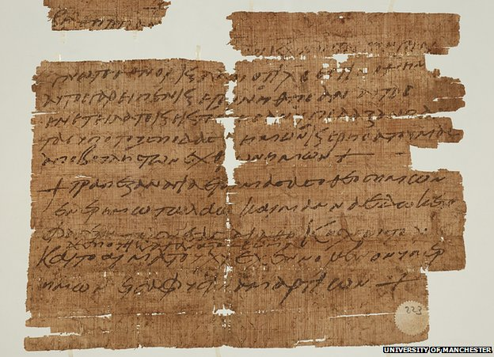
John Rylands library - Papyrus
1,500 years old
Just found by
Roberta Mazza
Been in library
since 1901
"It is a text which was probably inscribed by a monk or a priest to protect the bearer from any kind of evil. This piece of papyrus would have been folded and suspended around their neck, either just with string or in a nice locket.“ (Mazza)
Notes:
Maybe, maybe not:
KNOWN
Relative age of the manuscript, which seems to refer to the Lord’s Supper
On the other side of a receipt paid for a grain tax (almost unreadable)
Folded (the religious sentiment has text that is more well preserved (on inside)
SPECULATION
Who wrote the passage (monk or priest, for a common man)
Purpose of writing the passage (magic charm, mimicking the Egyptian practice)
How used (worn as an amulet around neck). No amulet or string found with the parchment.
Quote: "It's one of the first recorded documents to use magic in the Christian context and the first charm ever found to refer to the Eucharist - the Last Supper - as the manna of the Old Testament.“
Q: Why not the practice of the Jews with their phylacteries? Or even a scribbled note?

Slide 28
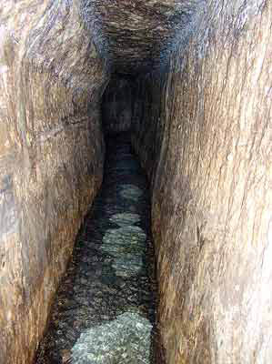
Hezekiah’s Tunnel
2 Chronicles 32:1-8
Siege of Jerusalem by Assyrian King Sennacherib.
Water source enabled the Jews to withstand the siege.
Note: Main water source, Gihon spring, had to be outside of the walls, for the walls to be high enough to serve as protection.
Notes:
Hezekiah's tunnel, discovered in 1838 by the American biblical scholar Edward Robinson, can be walked through today from end to end. Brings water from the Gihon spring into the pool of Siloam within the city walls.

Slide 29
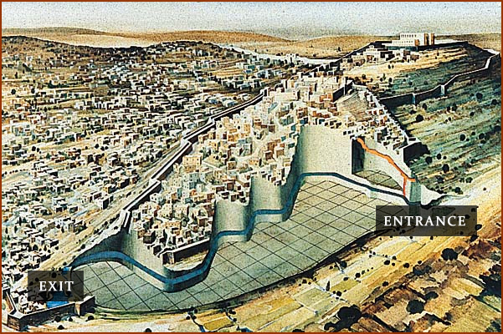
Hezekiah’s Tunnel - 2
Notes:
Entrance to the Tunnel is at the Gihon Spring
Exit from the tunnel is at the pool of Siloam in the lower part of the city.
Through solid bedrock, 1750 feet long
130 feet below the ground, follows a precise grade of about 0.6%
Date of digging has been confirmed by the following: (8th century B.C., time of Hezekiah’s reign)
Carbon 14 dating of plants disturbed by digging
Analysis of ancient writing of the Siloam inscription
Uranium-thorium dating of stalactites and stalagmites formed since the digging of the tunnel.
You can walk the tunnel today. (shoulder wide, must stoop sometimes, cold water around your ankles)

Slide 30
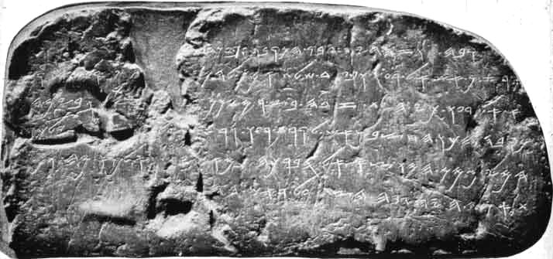
Hezekiah’s Tunnel - 3
Other verses:
  2 Kings 20:20
  2 Chronicles 32:30
  Isaiah 22:11
Siloam inscription found in tunnel (1880)
  Found 19 feet inside the tunnel near the pool of Siloam.
  Describes the construction of the tunnel. Two crews working from ends, meeting in middle.
  Inscription in ancient Hebrew language
Notes:
Note: The inscription was removed and broken in 1891. Was found, reassembled and is now in Istanbul Archaeology Museum. (A replica inscription can be found in the tunnel).
(2 Kings 20:20), “Now the rest of the acts of Hezekiah—all his might, and how he made a pool and a tunnel and brought water into the city—are they not written in the book of the chronicles of the kings of Judah?”
(2 Chronicles 32:30), “This same Hezekiah also stopped the water outlet of Upper Gihon, and brought the water by tunnel^{[g]} to the west side of the City of David. Hezekiah prospered in all his works.”
(Isaiah 22:11), [Woe against Jerusalem] “You also made a reservoir between the two walls For the water of the old pool. But you did not look to its Maker, Nor did you have respect for Him who fashioned it long ago.”

Slide 31
Taylor Prism
One of three prisms discovered (Sennacherib & Jerusalem Prisms)
Discovered in Nineveh in 1830 by Colonel Robert Taylor
Almost identical text to the other prisms
Believed to have been inscribed in 690 B.C. (Note: Siege of Jerusalem, 701 B.C.)
Notes:
Only a single decade between the siege, and the creation of this prism.

Slide 32
Taylor Prism
Records the first 8 campaigns of
King Sennacherib of Assyria
(cf. 2 Chronicles 32:1-23)
15” X 5” baked clay (6 sides)
Details his campaign (3rd)
against Hezekiah of Judah
Note: Details do not coincide
exactly with Bible account. But,
does indicate a siege, not the
destruction of Jerusalem.
Notes:
READ ACCOUNT: (esp., verses 10-15; 20-23)
Last Point: It is interesting that while details of other campaigns describe total capitulation and defeat – habitation and destruction of the cities; Sennacherib’s own description of his interaction with Hezekiah describes only a siege of Jerusalem, and the extraction of tribute).

Slide 33
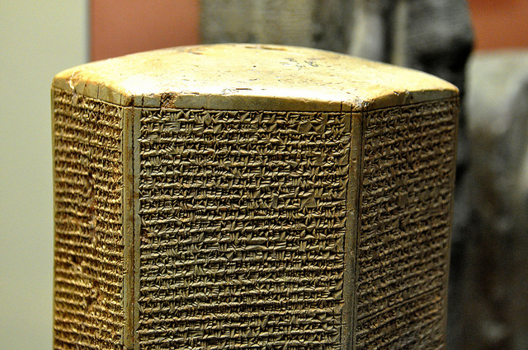
Taylor Prism - Quote
“(Hezekiah) himself, like a caged bird I shut up in Jerusalem, his royal city. I threw up earthworks against him— the one coming out of the city-gate, I turned back to his misery.”
He also claimed to have extracted tribute.
Notes:
Note: Read 2 Chronicles 32:11-ff Note claims of Sennacharib:
(11) Would die
(15) No deliverance
(17) God ineffectual
(20-23) His destruction!
Entire quote:
As for Hezekiah the Judahite, who did not submit to my yoke: forty-six of his strong, walled cities, as well as the small towns in their area, which were without number, by levelling with battering-rams and by bringing up seige-engines, and by attacking and storming on foot, by mines, tunnels, and breeches, I besieged and took them. 200,150 people, great and small, male and female, horses, mules, asses, camels, cattle and sheep without number, I brought away from them and counted as spoil. (Hezekiah) himself, like a caged bird I shut up in Jerusalem, his royal city. I threw up earthworks against him— the one coming out of the city-gate, I turned back to his misery. His cities, which I had despoiled, I cut off from his land, and to Mitinti, king of Ashdod, Padi, king of Ekron, and Silli-bêl, king of Gaza, I gave (them). And thus I diminished his land. I added to the former tribute, and I laid upon him the surrender of their land and imposts—gifts for my majesty. As for Hezekiah, the terrifying splendor of my majesty overcame him, and the Arabs and his mercenary troops which he had brought in to strengthen Jerusalem, his royal city, deserted him. In addition to the thirty talents of gold and eight hundred talents of silver, gems, antimony, jewels, large carnelians, ivory-inlaid couches, ivory-inlaid chairs, elephant hides, elephant tusks, ebony, boxwood, all kinds of valuable treasures, as well as his daughters, his harem, his male and female musicians, which he had brought after me to Nineveh, my royal city. To pay tribute and to accept servitude, he dispatched his messengers.

Slide 34
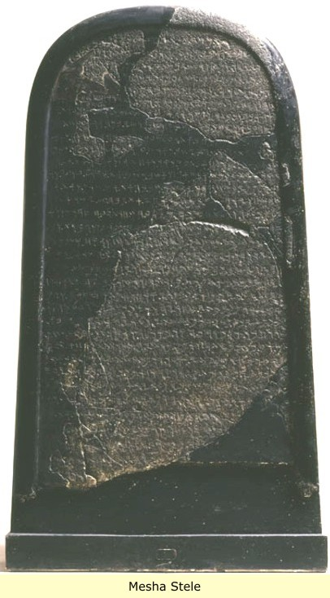
Moabite Stone
Also known as Mesha Stele
Inscribed stone from 830 B.C.
King Mesha of Moab, (modern day Jordan)
Discovered by Anglican missionary Frederick Augustus Klein in August 1868, at ancient site of Dibon
Smashed by local villagers the next year
Notes:
Note: In the picture, the lighter sections represent what actually remains of the Moabite stone after it was smashed into pieces (about 637 letters of an original approx. 1000. The rest is a reconstruction based upon a paper “squeeze” that was taken shortly before the stone was smashed.
The reconstruction of the text was done by French archaeologist Charles Simon Clermont-Ganneau
Complete Text: I am Mesha, son of Chemosh-gad, king of Moab, the Dibonite. My father reigned over Moab thirty years, and I have reigned after my father. And I have built this sanctuary for Chemosh in Karchah, a sanctuary of salvation, for he saved me from all aggressors, and made me look upon all mine enemies with contempt. Omri was king of Israel, and oppressed Moab during many days, and Chemosh was angry with his aggressions. His son succeeded him, and he also said, I will oppress Moab. In my days he said, Let us go, and I will see my desire upon him and his house, and Israel said, I shall destroy it for ever. Now Omri took the land of Madeba, and occupied it in his day, and in the days of his son, forty years. And Chemosh had mercy on it in my time. And I built Baal-meon and made therein the ditch, and I built Kiriathaim. And the men of Gad dwelled in the country of Ataroth from ancient times, and the king of Israel fortified Ataroth. I assaulted the wall and captured it, and killed all the warriors of the city for the well-pleasing of Chemosh and Moab, and I removed from it all the spoil, and offered it before Chemosh in Kirjath; and I placed therein the men of Siran, and the men of Mochrath. And Chemosh said to me, Go take Nebo against Israel, and I went in the night and I fought against it from the break of day till noon, and I took it: and I killed in all seven thousand men, but I did not kill the women and maidens, for I devoted them to Ashtar-Chemosh; and I took from it the vessels of Jehovah, and offered them before Chemosh. And the king of Israel fortified Jahaz, and occupied it, when he made war against me, and Chemosh drove him out before me, and I took from Moab two hundred men in all, and placed them in Jahaz, and took it to annex it to Dibon. I built Karchah the wall of the forest, and the wall of the Hill. I have built its gates and I have built its towers. I have built the palace of the king, and I made the prisons for the criminals within the wall. And there were no wells in the interior of the wall in Karchah. And I said to all the people, ‘Make you every man a well in his house.’ And I dug the ditch for Karchah with the chosen men of Israel. I built Aroer, and I made the road across the Arnon. I took Beth-Bamoth for it was destroyed. I built Bezer for it was cut down by the armed men of Daybon, for all Daybon was now loyal; and I reigned from Bikran, which I added to my land. And I built Beth-Gamul, and Beth-Diblathaim, and Beth Baal-Meon, and I placed there the poor people of the land. And as to Horonaim, the men of Edom dwelt therein, on the descent from old. And Chemosh said to me, Go down, make war against Horonaim, and take it. And I assaulted it, And I took it, for Chemosh restored it in my days. Wherefore I made.... ...year...and I...

Slide 35
Moabite Stone
(2 Kings 3:4-8, 26-27)
Moabite stone describes this event from the Moabite perspective.
Refers by name to Omri, and refers to “his son” (Ahab) as well as corroborating the Biblical reference to Mesha.
“I am Mesha … Omri was king of Israel, and oppressed Moab during many days, and Chemosh was angry with his aggressions. His son succeeded him, and he also said, I will oppress Moab.
Notes:
Point 3 (The stone contains references to:)
“House of Omri” (King of Israel)
The earliest extra-Biblical reference to Yahweh, the God of Israel
Possibly a reference to “House of David” (Kingdom of Judah)
Quote about Jehovah: “And Chemosh said to me, Go take Nebo against Israel, and I went in the night and I fought against it from the break of day till noon, and I took it: and I killed in all seven thousand men, but I did not kill the women and maidens, for I devoted them to Ashtar-Chemosh; and I took from it the vessels of Jehovah, and offered them before Chemosh.”
Quote about House of David, referred to in Wikipedia: “This section is badly damaged, but appears to tell of Mesha's reconquest of the southern lands of Moab, just as the earlier part dealt with victories in the north. Line 31 says that he captured Horonen from someone who was occupying it. Just who the occupants were is unclear. The legible letters are BT[*]WD, with the square brackets representing a damaged space that probably contained just one letter. Andre Lemaire has reconstructed this as BT[D]WD, "House of David", meaning Judah. This is not universally accepted - Nadav Na'aman, for instance, reads it as BT[D]WD[H], "House of Daodoh", a local ruling family;^{[19]} but if Lemaire is correct, then this is the earliest evidence of the existence of the Judean kingdom and its Davidic dynasty.”

Slide 36
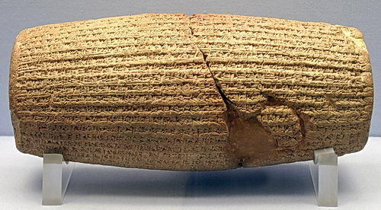
Cyrus Cylinder
Baked clay. Now in several fragments. 4 inches by 9 inches long. Created in 539 B.C.
The Assyro-British archaeologist Hormuzd Rassam discovered the Cyrus Cylinder in March 1879 during a lengthy program of excavations in Mesopotamia carried out for the British Museum
The text extols the virtues of the new King of Persia, Cyrus
Notes:
Text

Slide 37
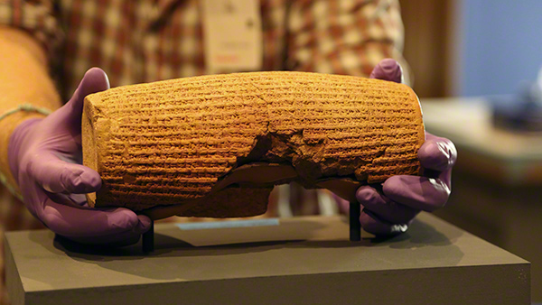
Cyrus Cylinder
Ezra 11:1-11
Babylonians displaced the people, but under Cyrus, the Persians restored sanctuaries, and allowed the people to return to their lands after 70 years of exile.
Quote: “I returned the images of the gods, who had resided there [i.e., in Babylon], to their places and I let them dwell in eternal abodes. I gathered all their inhabitants and returned to them their dwellings.”
Notes:
The text of the Cylinder confirms that Cyrus policy was to repatriate the peoples displaced by Nebuchadnezzar, and to return the religious artifacts to them.

Slide 38
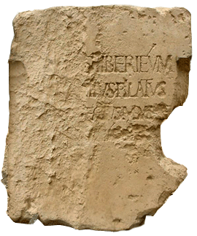
Pilate STone
Discovered in 1961 at Caesarea Maritima (on the shore of the Mediterranean)
Caesarea was the Roman capital of Judea during the time of Jesus
Discovered by Dr. Antonio Frova, Italian archaeologist
Until then, there was no corroboration of the Biblical reference to the man
Notes:
A large limestone block.
The limestone block was discovered in June 1961 by Italian archaeologists led by Dr. Antonio Frova while excavating an ancient theater (built by decree of Herod the Great c. 30 BC). The stone had been reused in the 4th century as part of a set of stairs leading up to the seating and was discovered in situ.[9] The theatre is located in a town that was called Caesarea Maritima in the present-day city of Caesarea-on-the-Sea (also called Maritima).

Slide 39
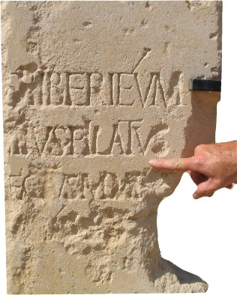
Pilate STone
(Matthew 27:11-14)
Inscription reads:
To the divine Augusti…
[this] Tiberium
Pontius Pilate
Prefect of Judea
Has dedicated [this}
Notes:
On the partially damaged block is a dedication to the deified Augustus and Livia ("the Divine Augusti") of a Tiberieum (a building in honour of Tiberius Caesar Augustus). It has been deemed authentic because it was discovered in the coastal town of Caesarea, which was the capital of Iudaea Province[8] during the time Pontius Pilate was Roman governor.
The partial inscription reads (conjectural letters in brackets):^{[3]}
[DIS AUGUSTI]S TIBERIÉUM
[...PO]NTIUS PILATUS
[...PRAEF]ECTUS IUDA[EA]E [...FECIT D]E[DICAVIT]

Slide 40
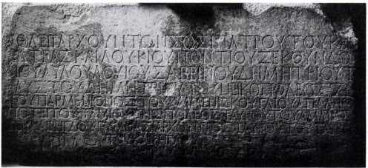
Politarch Inscription
Greek inscription discovered in 1835 on an arch in Thessalonika
Dated to the 2nd century A.D. (or, 30-143 A.D.)
Presently resides in the British museum
Since then, numerous other discoveries of the use of the term “politarch” to describe city leaders.
(Luke 1:1-4) Note: Claim of accuracy
Acts 17:5-6
Notes:
The inscription describes six different politarchs.
Greek – poli (people) arch (ruler)
“Rulers of the people”
The term is correctly used by Luke in Acts 17
Note: Other sources I consulted gave the date of 1835 as the discovery of the arch and inscription, noting that the arch was later destroyed in 1867. (The inscription remains, and is in the British Museum).

Slide 41
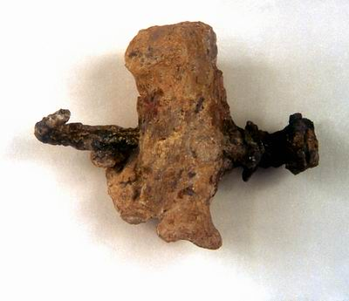
Use of nails in Roman Crucifixions
Discovered in Givat HaMivtar (a neighborhood in Jerusalem)
This neighborhood is the location of a number of ancient tombs.
“the remains of a person called Jehohanan Ben Khagqol, … included a heel bone with a nail driven through it from the side. The tip of the nail was bent, perhaps because of striking a knot in the upright beam, which prevented it being extracted from the foot.” (Wikipedia)
Notes:
This is a rare piece of physical evidence of the Roman practice of crucifixion.
Found in 1968
Accidentally discovered when construction workers uncovered a Jewish tomb.
Traces of wood were found at both ends of the nail
This crucifixion was believed to have taken place in the first century.
Note: The more common method of crucifixion may have been to use ropes to bind the arms (at least), BUT, this find does corroborate the Biblical account of Christ’s crucifixion.

Slide 42
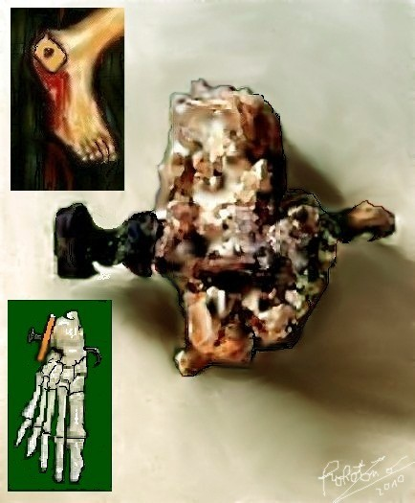
Use of nails in Roman Crucifixions
To the right, an artist’s conception of the nail used to crucify Jehonanan
John 20:25
Cf. Colossians 2:4

Slide 43
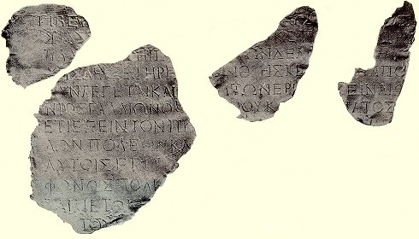
Gallio Letter
(Acts 18:12)
Gallio revealed by Luke to be proconsul of Achaia (Corinth) refused to act on the Jews’ accusations when they rose up against Paul.
Letter fragments found in Delphi, Greece from Emperor Claudias to proconsul Gallio (52 A.D.)
Called “Delphi inscription”, and discovered early in the 20th century.
Notes:
Note: A proconsul generally ruled only for a year. This is a precise corroboration of Luke’s narrative regarding Paul’s journeys.
The letter reveals that Claudius was begin acclaimed for the 26th time, which happened in the spring of A.D. 52.
The reconstructed inscription begins thus:
Tiber[ius Claudius Cae]sar Augustus Ge[rmanicus, invested with tribunician po]wer [for the 12th time, acclaimed Imperator for t]he 26th time, F[ather of the Fa]ther[land...]. For a l[ong time have I been not onl]y [well-disposed towards t]he ci[ty] of Delph[i, but also solicitous for its pro]sperity, and I have always guard[ed th]e cul[t of t]he [Pythian] Apol[lo. But] now [since] it is said to be desti[tu]te of [citi]zens, as [L. Jun]ius Gallio, my fri[end] an[d procon]sul, [recently reported to me, and being desirous that Delphi] should retain [inta]ct its for[mer rank, I] ord[er you (pl.) to in]vite well-born people also from [ot]her cities [to Delphi as new inhabitants....]

Slide 44
Luke’s Historical Accuracy
“Here is another amazing fact. In the book of Acts, the historian Luke mentions thirty-two countries fifty-four cities, and nine of the Mediterranean Islands” (Metzger, 1965, page 171)
There is not the slightest mistake in his references
Early criticisms of Luke’s historical accuracy has waned as more and more discoveries are made.
With each archaeological discovery, the text of the Bible is reinforced as accurate! Thus, the claims of inspiration are strengthened.

Slide 45
Scientific Foreknowledge
Biblical Examples of scientific truth, not available or widely known at the time of writing, Serve to indicate the inspiration of scripture.
Notes:
Note:
The Bible is NOT a science textbook. Figurative language (ex: the “heart” as the center of emotion, etc.), should not be construed as inaccurate.
We should not expect references to contain scientific jargon or terms.
However, on occasion the Bible contains information that reveals a knowledge of geographical features, nutrition, hygiene, etc., that was not available naturally to the inspired writers.
Five examples are included in material as examples of this proof…

Slide 46
Circumcision on the 8th day
(Genesis 17:12), “He who is eight days old among you shall be circumcised, every male child in your generations, he who is born in your house or bought with money from any foreigner who is not your descendant.”
God’s covenant with Abraham and his descendants. Circumcision a sign of that covenant (cf. vs. 11).
Circumcision – Removal of male foreskin. A minor surgical procedure that causes bleeding.

Slide 47
Circumcision on the 8th day
Holt and McIntosh, in their classic work, Holt Pediatrics, observed that a newborn infant has “peculiar susceptibility to bleeding between the second and fifth days of life.... Hemorrhages at this time, though often inconsequential, are sometimes extensive; they may produce serious damage to internal organs, especially to the brain, and cause death from shock and exsanguination” (1953, pp. 125-126).

Slide 48
Circumcision on the 8th day
Vitamin K is responsible for the liver’s production of prothrombin.
Vitamin K, coupled with prothrombin, causes blood coagulation, which is important in any surgical procedure.
It is not until days 5-7 that Vitamin K levels are adequate (produced by bacteria in the intestinal tract).
Day 8 is the only day that available prothrombin levels are above normal in a healthy male’s life (110%).
Notes:
The 110% figure is taken from a chart, from an article on the Apologetics Press website. (http://www.apologeticspress.org/apcontent.aspx?category=13&article=1118)
Days 1-5 the level drops from 80% to 40% on day three, and then back up to 80%
The discovery made by Medical Research corroborates the instructions given by God to Abraham.

Slide 49
None of These Diseases (page 93, 1984)
“We should commend the many hundreds of workers who labored at great expense over a number of years to discover that the safest day to perform circumcision is the eighth. Yet, as we congratulate medical science for this recent finding, we can almost hear the leaves of the Bible rustling. They would like to remind us that four thousand years ago, when God initiated circumcision with Abraham....
“Abraham did not pick the eighth day after many centuries of trial-and-error experiments. Neither he nor any of his company from the ancient city of Ur in the Chaldees ever had been circumcised. It was a day picked by the Creator of vitamin K.” (S.I. McMillen, M.D.).

Slide 50
Dietary Restrictions (Ex: Pork)
To the Jew, the pig was unclean. “And the swine, though it divides the hoof, having cloven hooves, yet does not chew the cud, is unclean to you. ⁸ Their flesh you shall not eat, and their carcasses you shall not touch. They are unclean to you” (Leviticus 11:7-8).
Note: There is no indication that any other ancient civilization had such complex rules concerning diet and hygiene.

Slide 51
Dietary Restrictions (Ex: Pork)
Pigs are scavengers, and often ingest parasites:
Trichinella spiralis, which is the cause of trichinosis in humans.
Pigs are known carriers (as intermediate hosts) of the tapeworm, Taenia solium.
The parasite Echinococcus granulosis, can cause tumors in the liver, lungs, and other parts of the body.
Raw and undercooked pork can be dangerous for humans to eat.

Slide 52
Trichinellosis less common today
“Infection used to be more common and was usually caused by ingestion of undercooked pork. However, infection is now relatively rare. During 2008–2010, 20 cases were reported per year on average. The number of cases decreased beginning in the mid-20th century because of legislation prohibiting the feeding of raw-meat garbage to hogs, commercial and home freezing of pork, and the public awareness of the danger of eating raw or undercooked pork products. Cases are less commonly associated with pork products and more often associated with eating raw or undercooked wild game meats.” (www.cdc.gov/parasites...)
Notes:
Center for Disease Control
http://www.cdc.gov/parasites/trichinellosis/gen_info/faqs.html

Slide 53
Quarantine of Lepers
“Now the leper on whom the sore is, his clothes shall be torn and his head bare; and he shall cover his mustache, and cry, ‘Unclean! Unclean!’ ⁴⁶ He shall be unclean. All the days he has the sore he shall be unclean. He is unclean, and he shall dwell alone; his dwelling shall be outside the camp” (Leviticus 13:45-46).
“Although the mode of transmission of leprosy remains uncertain, many think that M. leprae is usually spread from person to person in nasal droplets.” (Wikipedia)
Notes:
Note: Isolation or Quarantine
Also: the unclean was to warn those who drew close, covering his mustache before crying out.

Slide 54
Encyclopedia of Medical History
“The idea of contagion was foreign to the classic medical tradition and found no place in the voluminous Hippocratic writings. The Old Testament, however, is a rich source for contagionist sentiment, especially in regard to leprosy and venereal disease”
(McGrew, 1985, pp.77-78).

Slide 55
A Sketch of Medicine and Pharmacy
“In the prevention of disease, however, the ancient Hebrews made real progress. The teachings of Moses, as embodied in the Priestly Code of the Old Testament, contain two clear conceptions of modern sanitation—the importance of cleanliness and the possibility of controlling epidemic disease by isolation and quarantine”
(S.E. Massengill, 1943, p. 252).

Slide 56
Practice of Quarantine in History
The word "quarantine" originates from the Venetian dialect form of the Italian quaranta giorni, meaning 'forty days'. This is due to the 40 day isolation of ships and people before entering the city of Dubrovnik in Croatia. This was practiced as a measure of disease prevention related to the Black Death. Between 1348 and 1359, the Black Death wiped out an estimated 30% of Europe's population, and a significant percentage of Asia's population. The original document from 1377, which is kept in the Archives of Dubrovnik, states that before entering the city, newcomers had to spend 30 days (a trentine) in a restricted place (originally nearby islands) waiting to see whether the symptoms of Black Death would develop. Later, isolation was prolonged to 40 days and was called quarantine. (Wikipedia)
Notes:
http://en.wikipedia.org/wiki/Quarantine#History
Was practiced earlier to one extent or another, but it was not until much later that the knowledge of contagion transmission was understood.

Slide 57
Touching Dead Bodies
“He who touches the dead body of anyone shall be unclean seven days. ¹² He shall purify himself with the water on the third day and on the seventh day; then he will be clean. But if he does not purify himself on the third day and on the seventh day, he will not be clean.” (Numbers 19:11-12).
Medical science today recognizes the unhygienic nature of handling dead bodies. But, in 1847, this was not known, as illustrated by the observations of Ignaz Semmelweis.

Slide 58
Touching Dead Bodies
Ignaz Semmelweis, (obstetrician) Director of a maternity ward in Vienna, Austria (1847)
18% of pregnant women (1 in 6) who checked into the ward died of “labor fever”
Autopsies revealed pus in chest cavities, under the skin, in eye sockets, etc.
Death when a midwife was used only 3%
  He turned all women on their sides
  Made priest stop ringing bell during visits, thinking that it might be scaring the women.

Slide 59
Touching Dead Bodies
In observing the routines of young medical students…
  Performed autopsies on the dead mothers
  Rinsed their hands in dirty (bloody) water
  Wiped them on common, shared towel
  Immediately went to patients for internal examinations and treatment
He ordered thorough hand washing in chlorine between each examination, and the death rate fell to 1% in three months.
Notes:
Source for this account, None of These Diseases, (S.I. McMillen and David Stern)

Slide 60
Deep Sea Trenches
“In the six hundredth year of Noah’s life, in the second month, the seventeenth day of the month, on that day all the fountains of the great deep were broken up, and the windows of heaven were opened.” (Genesis 7:11)
“Have you entered the springs of the sea? Or have you walked in search of the depths?” (Job 38:16)
“Whatever the Lord pleases He does, In heaven and in earth, In the seas and in all deep places.” (Psalm 135:6)
Notes:
(Genesis 7:11) Hebrew word for “the great deep” TEHOM
Definition: an abyss. Abyssal deep.
Definition: abyss - a deep or seemingly bottomless chasm. Gorge, ravine, fissure, crevasse.

Slide 61
Deep Sea Trenches
“For many centuries, man considered the seashore as little more than a shallow, sandy extension that went from one continent to another. Then, in 1873 a group of British scientists carrying out research in the Pacific Ocean discovered a “recess” (trench) 35,800 feet deep. A trench is a long, narrow depression in the ocean floor that looks like an enormous gash with extremely steep sides. The topography and depth of these trenches are used to distinguish them from other valleys and depressions in the oceans.”
Bert Thompson, PhD.
Notes:
In fact, it is in only the last 100 years or so that science has been able to map and partially explore these deep sea trenches.
Extensive studies have been carried out on the Marianas Trench off the coast of Guam. In fact, (in 1960) a research team, using the bathyscaph Trieste, traveled over six miles down to “Challenger Deep” the deepest spot in the ocean. Nearly 11 kilometers, around 36,000 feet)
In 2012 James Cameron piloted the DEEPSEA CHALLENGER to Challenger Deep, replicating the journey of the Trieste.
I came across a timeline of 100 years of trench research that was very interesting, it is at the following URL:
http://tinyurl.com/qaw5m3o

Slide 62
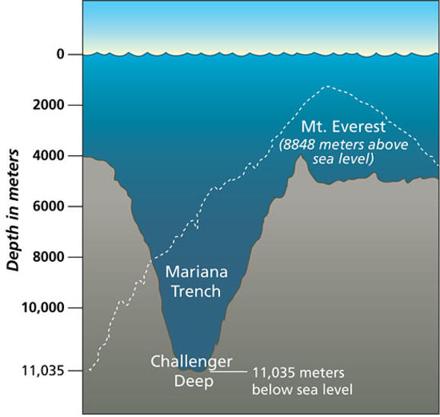
Deep Sea Trenches
The deepest trench in the world is the Mariana trench, reaching to a depth of over 36,000 feet. Mt. Everest can fit in there and with some room to spare.

Slide 63
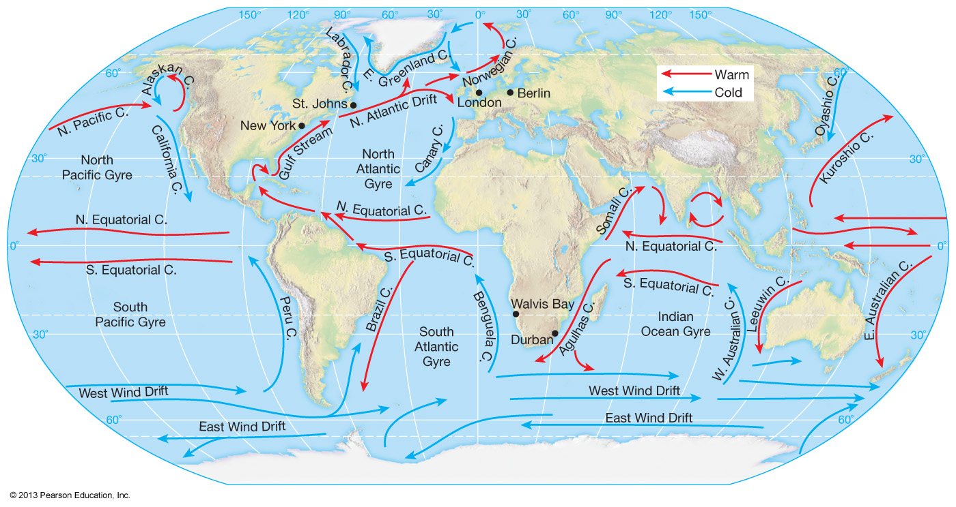
Ocean Currents
“The birds of the air, And the fish of the sea that pass through the paths of the seas.” (Psalm 8:8)
Notes:
The Psalmist couldn’t have “naturally” known of the paths of the seas. However, they do exist, and have been well charted.

Slide 64
Ocean Currents
“I have been blamed by men of science, both in this country and in England, for quoting the Bible in confirmation of the doctrines of physical geography. The Bible, they say, was not written for scientific purposes, and is therefore no authority in matters of science. I beg pardon! The Bible is authority for everything it touches. What would you think of an historian who should refuse to consult historical records of the Bible, because the Bible was not written for the purposes of history? The Bible is true and science is true.”
Matthew Fontaine Maury (1806-1873)
Notes:
Maury born in Virginia, joined US Navy at age 19 (Academic)
Appointed in 1842 Superintendent of the Depot of Charts and Instruments
Has been called: Pathfinder of the Seas
He used old log books and thousands of new observations to produce his famous wind and current charts of the world’s major oceans.
Wrote “The Physical Geography of the Sea”, published in 1855 (Considered the genesis of the science of Oceanography
Note: It is popularly claimed that Maury was moved to search for the ocean currents because of the Bible. Apparently not so. Also, some currents, such as the Gulf Stream were well known by the 1840’s. But, that doesn’t change the fact that they were unknown in the Psalmist’s time. Maury was convinced of the inspiration of scripture, as seen in the above quote.
http://www.apologeticspress.org/apcontent.aspx?category=13&article=361

Slide 65
Count the Stars
“Then He brought him outside and said, “Look now toward heaven, and count the stars if you are able to number them.” And He said to him, “So shall your descendants be.” (Genesis 15:5)
Notes:
God’s nation promise to Abraham
¹⁹ And the word of the Lord came to Jeremiah, saying, ²⁰ “Thus says the Lord: ‘If you can break My covenant with the day and My covenant with the night, so that there will not be day and night in their season, ²¹ then My covenant may also be broken with David My servant, so that he shall not have a son to reign on his throne, and with the Levites, the priests, My ministers. ²² As the host of heaven cannot be numbered, nor the sand of the sea measured, so will I multiply the descendants of David My servant and the Levites who minister to Me.’” (Jeremiah 33:19-22)

Slide 66
Count the Stars
Hipparchus, ancient Greek astronomer, gave estimates regarding the number of stars between 800 and 1800 (200 B.C.)
Chang Hing (A.D. 100), a Chinese cartographer, put the number around 2500, “not including those which the sailors observe.”
Many other ancient writers have estimated the number of stars to be relatively low.
Modern knowledge, over 25 sextillion stars in the universe.

Slide 67
25 Sextillion
25,000,000,000,000,000,000,000
Notes:
That’s a lot!

Slide 68
Waters of Purification
Numbers 19:1-9
Water of purification used for “purifying from sin” (vs. 9).
But, had practical use as well, as it was used after handling a dead body, (verses 11-ff).
Ingredients – ashes of a red heifer, hyssop, cedar wood, scarlet (wool, cf. Heb. 9:19), and water.
Article at Apologetics Press, titled: God’s Soap Recipe, claims that such a concoction would have antibacterial properties!
Notes:
Last bullet point. Actually are repeating a claim made in the book, None of these Diseases, published in 2000 by S.I. McMillen, M.D. & David E. Stern, M.D. The book expresses Biblical principles to promote healthy living.

Slide 69
Waters of Purification
Lye is created by pouring water through ashes. (Highly alkaline). Lye soap combines lye and tallow or lard.
Hyssop contains the antiseptic thymol
Oil from Cedar wood contains a mild irritant that could encourage scrubbing.
The scarlet wool added wool fibers to the concoction, making it the “ancient equivalent of Lava® soap” (None of These Diseases, McMillen & Stern, 2000, p. 25)
Notes:
You can research lye soap recipes on the internet. Most common method was combining wood ashes and animal fat, and pouring water through the mixture.
Thymol used in many modern mouthwashes. Hyssop oil is expensive, and still today used by many as a healing oil.
This is the one claim made that I wonder if it is a bit of a stretch.
I liked the quote about scarlet wool, so I included it. McMillen & Stern are two doctors who use Biblical principles to promote healthy living.

Slide 70
Fulfilled Prophecy
Biblical prophecy, especially if it has extra-biblical verification, is strong evidence of inspiration.
Notes:
Note:
The credibility of a prophet is based upon whether his prophecy comes true!
Harold Camping (End of world May 2011, then October 2011), Didn’t happen!
We knew it wouldn’t because that would contradict scripture (cf. 2 Peter 3:9-10) “The day of the Lord will come as a thief in the night.”
(Deuteronomy 18:20-22), “But the prophet who presumes to speak a word in My name, which I have not commanded him to speak, or who speaks in the name of other gods, that prophet shall die.’ ²¹ And if you say in your heart, ‘How shall we know the word which the Lord has not spoken?’— ²² when a prophet speaks in the name of the Lord, if the thing does not happen or come to pass, that is the thing which the Lord has not spoken; the prophet has spoken it presumptuously; you shall not be afraid of him.”
(Isaiah 41:21-24) Futility of Idols (Read)

Slide 71
Valid Prophecy
1) “It must be a specific, detailed declaration, as opposed to being nebulous, vague, or general in nature.”
2) “There must be a sufficient amount of time between the prophetic statement and its fulfillment.”
3) “The prophecy must be stated in clear, understandable terms.”
4) “The prophecy must not have historical overtones.”
Bert Thompson, PhD.
Notes:
Note: Read further explanation of each point, with corroboration, in the Notes of book. Page 11-13.

Slide 72
Nebulous Predictions - Nostradamus
September 11, 2001 Terror Attack?
Earthshaking fire from the center of the Earth
Will cause tremors around the New City.
Two great rocks will war for a long time,
Then Arethusa will redden a new river.
Notes:
Michel de Nostredame (aka Nostradamus) was a 16th-century French "seer." We don't have many seers these days.
Nostradamus studied astrology and various "occult" sciences and used those to predict the future.
He's best known for The Prophecies, a collection of French quatrains published in 1555. So are these prophecies worthy predictions of the future or merely vague observations retrofitted to match past events?
Fiery explosion of Jumbo jets – Two great rocks the twin towers – the New City New York City

Slide 73
Nebulous Predictions - Nostradamus
Rise of Hitler, World War II?
From the depths of the West of Europe,
A young child will be born of poor people,
He who by his tongue will seduce a great troop;
His fame will increase towards the realm of the East.
Notes:
Note: Part of this prophecies popularity was the spelling of a word used by Nostradamus – the latin word Hister. Close to Hitler, however it was a Latin word used to describe the Danube River, in the sentence immediately preceding this quatrain.
From the Rhine and Lower Danube they will be said to have come,
Cries, tears at Malta and the Ligurian side.

Slide 74
Nebulous Predictions - Nostradamus
Atomic Bombing – Hiroshima & Nagasaki?
Near the gates and within two cities
There will be scourges the like of which was never seen,
Famine within plague, people put out by steel,
Crying to the great immortal God for relief.
Notes:
Note: So vague it could refer to many different war atrocities through the ages.

Slide 75
Destruction of Babylon
Fear of Babylon Jeremiah 51:30
How remarkably this conforms to the actual history. Xenophon said that when Cyrus brought his army to Babylon, he initially was perplexed as to how he would take the city, since the Chaldean soldiers “do not come out to fight” (Cyropaedia VII.V.7). The Babylonians fearfully remained behind their massive walls refusing, for the most part, to encounter the enemy—exactly as the prophet had indicated.
Notes:
First, read Jeremiah 50:1-3 Note: This is odd 100 years previous to the siege, as Babylon was the most powerful Empire that had to that time existed.
Quote: https://www.christiancourier.com/articles/38-babylon-a-test-case-in-prophecy-part-2
Read also:
50:8-10
50:18-20 (Note: Cyrus quickly restored the Jews to their land).
51:24
51:27-32
51:63-64 (Certainty of the fulfillment)

Slide 76
Destruction of City of Tyre
Ezekiel 26 (Written in 586 B.C.)
Ezekiel 26:1-14, 19-21
“Several aspects of this prophecy deserve attention and close scrutiny. The prophet predicted: (1) many nations would come against Tyre; (2) the inhabitants of the villages and fields of Tyre would be slain; (3) Nebuchad-nezzar would build a siege mound against the city; (4) the city would be broken down and the stones, timber, and soil would be thrown in “the midst of the water;” (5) the city would become a “place for spreading nets;” and (6) the city would never be rebuilt.” (Kyle Butt)
Notes:
Ezekiel’s prophecy easily dated. 5 years after the captivity of Johoachin. (During 2nd deportation of citizens from Judea to Babylon). Documented in 2 Kings 24:10-20.
Since Ezekiel’s visions began five years after the deportation, then a firm date of 592 B.C. can be established for the beginning of his prophecy. The prophet supplies other specific dates such as the seventh year (20:1), the ninth year (24:1), the eleventh year (26:1), and the latest date given as the twenty-seventh year (29:17) [Note: for an outline see Archer, 1974, pp. 368-369]. Due to the firmly established dating system that Ezekiel chose to use for his prophecy, the date of the prophecy regarding the city of Tyre, found in chapter 26, can be accurately established as the eleventh year after 597, which would be 586 B.C.
Properly understood, the prophecy details travails of Tyre that had their beginning with Nebuchadnezzar only a few months after the prophecy was given, to the ultimate destruction of the city by Alexander the great in 332 B.C.
Note: Quote from… http://apologeticspress.org/apcontent.aspx?category=13&article=1790
“In his dealings with Tyre, Alexander asserted that he wished to make a personal sacrifice in the temple of Heracles on the island city of Tyre. Apparently, because the Tyrians considered their island refuge virtually impregnable, with war machines covering the walls, and rapidly moving water acting as an effective barrier from land attack, they refused his request. Upon receiving their refusal, Alexander immediately set to work on a plan to besiege and conquer the city. He set upon the task of building a land bridge or cause way (Siculus calls it a “mole”) from the mainland city of Tyre to the island city. Siculus stated: “Immediately he demolished what was called Old Tyre and set many tens of thousands of men to work carrying stones to construct a mole” (17.40). Curtius Rufus noted: “Large quantities of rock were available, furnished by old Tyre” (4.2.18). This unprecedented action took the Tyrians by complete surprise. Fleming noted: “In former times the city had shown herself well nigh impregnable. That Alexander’s method of attack was not anticipated is not strange, for there was no precedent for it in the annals of warfare” (p. 56). And yet, even though this action was unprecedented militarily, it was exactly what one might expect from the description of the destruction of Tyre given by Ezekiel hundreds of years prior to Alexander’s actions. The mainland city was demolished and all her stones, timber, and soil were thrown into the midst of the sea.”
In approximately A.D. 1170, a Jewish traveler named Benjamin of Tudela published a diary of his travels. “Benjamin began his journey from Saragossa, around the year 1160 and over the course of thirteen years visited over 300 cities in a wide range of places including Greece, Syria, Palestine, Mesopotamia and Persia” (Benjamin of Tudela, n.d.). In his memoirs, a section is included concerning the city of Tyre.
From Sidon it is half a day’s journey to Sarepta (Sarfend), which belongs to Sidon. Thence it is a half-day to New Tyre (Sur), which is a very fine city, with a harbour in its midst.... There is no harbour like this in the whole world. Tyre is a beautiful city.... In the vicinity is found sugar of a high class, for men plant it here, and people come from all lands to buy it. A man can ascend the walls of New Tyre and see ancient Tyre, which the sea has now covered, lying at a stone’s throw from the new city. And should one care to go forth by boat, one can see the castles, market-places, streets, and palaces in the bed of the sea (1907, emp. added.).

Slide 77
Messianic Prophecy
1) Approximately 300 messianic prophecies
2) Referenced internally in scripture. These are indications of the inspired nature of prophetic utterance.
For example, Proved Jesus’ claim as Messiah to open minded Jews on Pentecost (cf. Acts 2:22-32)
All these predictions centuries before his birth.

Slide 78
The Christ – Tribe of Judah
Genesis 49:10, “The scepter shall not depart from Judah, nor a lawgiver from between his feet, until Shiloh comes; and to Him shall be the obedience of the people.”
Hebrews 7:14, “For it is evident that our Lord arose from Judah, of which tribe Moses spoke nothing concerning priesthood.”
Notes:
Shiloh – A Hebrew name for the Messiah

Slide 79
The Christ – Royal Lineage
2 Samuel 7:12-13, “When your days are fulfilled and you rest with your fathers, I will set up your seed after you, who will come from your body, and I will establish his kingdom. ¹³ He shall build a house for My name, and I will establish the throne of his kingdom forever.”
Luke 1:32, “He will be great, and will be called the Son of the Highest; and the Lord God will give Him the throne of His father David.”
Notes:
God’s promise to David. The Messiah would be one of his descendants.
Note: Luke 1:32 was the angel’s announcement to Mary regarding her pregnancy
Fulfilled in Acts 2, in the establishment of the Kingdom of Christ (cf. Mark 9:1; Colossians 1:13)

Slide 80
The Christ – His place of Birth
Micah 5:2, “But you, Bethlehem Ephrathah, though you are little among the thousands of Judah, yet out of you shall come forth to Me the One to be Ruler in Israel, whose goings forth are from of old, From everlasting.”
Matthew 2:1, “Now after Jesus was born in Bethlehem of Judea in the days of Herod the king, behold, wise men from the East came to Jerusalem.”
Notes:
Bethlehem is a small village in Judah. The specifics surrounding Jesus’ birth, events such as Caesar’s census, and Joseph’s home town, all contributed to the improbable fulfillment of this prophecy (cf. Luke 2:1-5).

Slide 81
The Christ – His Virgin Birth
Isaiah 7:14, “Therefore the Lord Himself will give you a sign: Behold, the virgin shall conceive and bear a Son, and shall call His name Immanuel.”
Matthew 1:22-23, “So all this was done that it might be fulfilled which was spoken by the Lord through the prophet, saying: 23 ‘Behold, the virgin shall be with child, and bear a Son, and they shall call His name Immanuel,’ which is translated, ‘God with us.’”
Notes:
Words of Isaiah the prophet to Ahaz, King of Judah.
Events of Matthew 1 included the conception by the Holy Spirit, Joseph’s betrothal to Mary, and the birth of Jesus.

Slide 82
The Christ – His Galilean Ministry
Isaiah 9:1-2, “Nevertheless the gloom will not be upon her who is distressed, as when at first He lightly esteemed the land of Zebulun and the land of Naphtali, and afterward more heavily oppressed her, by the way of the sea, beyond the Jordan, in Galilee of the Gentiles. ² The people who walked in darkness have seen a great light; those who dwelt in the land of the shadow of death, upon them a light has shined.”
Matthew 4:12-17 (Fulfilled)
Notes:
(Matthew 4:12-17), “Now when Jesus heard that John had been put in prison, He departed to Galilee. ¹³ And leaving Nazareth, He came and dwelt in Capernaum, which is by the sea, in the regions of Zebulun and Naphtali, ¹⁴ that it might be fulfilled which was spoken by Isaiah the prophet, saying: ¹⁵ “The land of Zebulun and the land of Naphtali, By the way of the sea, beyond the Jordan, Galilee of the Gentiles: ¹⁶ The people who sat in darkness have seen a great light, And upon those who sat in the region and shadow of death Light has dawned.” ¹⁷ From that time Jesus began to preach and to say, “Repent, for the kingdom of heaven is at hand.”

Slide 83
The Christ – His Forerunner
Isaiah 40:3, “The voice of one crying in the wilderness: ‘Prepare the way of the Lord; make straight in the desert a highway for our God.”
Matthew 3:1-3, “In those days John the Baptist came preaching in the wilderness of Judea, ² and saying, ‘Repent, for the kingdom of heaven is at hand!’ ³ For this is he who was spoken of by the prophet Isaiah, saying: ‘The voice of one crying in the wilderness: “Prepare the way of the Lord; make His paths straight.”’”

Slide 84
The Christ – Time of His Appearance
Daniel 2:44, “And in the days of these kings the God of heaven will set up a kingdom which shall never be destroyed; and the kingdom shall not be left to other people; it shall break in pieces and consume all these kingdoms, and it shall stand forever.”
Luke 2:1, “And it came to pass in those days that a decree went out from Caesar Augustus that all the world should be registered.”
Notes:
“These kings” has reference to the 4th world empire – Of iron. The Roman Empire!
Jesus was born, died and his Kingdom was established during the reign of the Roman kings.

Slide 85
The Christ – Details Re: His Betrayal
Isaiah 50:6; 53:5; Psalm 22:16; Isaiah 53:12; Psalm 22:7-8; 22:18
Spit upon (Isaiah 50:6)
Was whipped before dying (Isaiah 53:5)
Nailed to the cross (Psalm 22:16)
Crucified with thieves (Isaiah 53:12)
Ridiculed at his death (Psalm 22:7-8)
Lots cast for his clothes (Psalm 22:18)
Matthew 27:30; Luke 24:39; Matthew 27:38; Matthew 27:39,35 (Fulfillment)
Notes:
Read Passages…
Matthew 27:30, Spat Upon
Matthew 27:26, Whipped before dying
Luke 24:39, Hands and feet pierced by nails
Matthew 27:38, Crucified with thieves
Matthew 27:39, Ridiculed at his death
Matthew 27:35, Lots cast for his clothes

Slide 86
The Christ – His Burial
Isaiah 53:9, “And they made His grave with the wicked—But with the rich at His death, because He had done no violence, nor was any deceit in His mouth.”
Matthew 27:57, 59-60, “Now when evening had come, there came a rich man from Arimathea, named Joseph, who himself had also become a disciple of Jesus… ⁵⁹ When Joseph had taken the body, he wrapped it in a clean linen cloth, ⁶⁰ and laid it in his new tomb which he had hewn out of the rock.”

Slide 87
The Christ – His Resurrection
Psalm 16:10, “For You will not leave my soul in Sheol, nor will You allow Your Holy One to see corruption.”
Matthew 28:5-6, “But the angel answered and said to the women, ‘Do not be afraid, for I know that you seek Jesus who was crucified. He is not here; for He is risen, as He said. Come, see the place where the Lord lay.”
Acts 2:22-32

Slide 88
The Christ – His Ascension
Psalm 110:1-3; 45:6
Jesus’ reign in Heaven as the living Lord was after His death on the cross
His reign on his throne is eternal in Heaven
Acts 1:9-11, “Now when He had spoken these things, while they watched, He was taken up, and a cloud received Him out of their sight. ¹⁰ And while they looked steadfastly toward heaven as He went up, behold, two men stood by them in white apparel, ¹¹ who also said, “Men of Galilee, why do you stand gazing up into heaven? This same Jesus, who was taken up from you into heaven, will so come in like manner as you saw Him go into heaven.”
Notes:
(Psalm 110:1-3), “The Lord said to my Lord, “Sit at My right hand, Till I make Your enemies Your footstool.” ² The Lord shall send the rod of Your strength out of Zion. Rule in the midst of Your enemies! ³ Your people shall be volunteers In the day of Your power; In the beauties of holiness, from the womb of the morning, You have the dew of Your youth.”
(Psalm 45:6), “Your throne, O God, is forever and ever; a scepter of righteousness is the scepter of Your kingdom.”

Slide 89
Kingdom Prophecy
Fulfillment of the Kingdom prophecies serve to establish the inspiration of the prophets.
A discussion of the texts serves to refute the false doctrine of Premillennialism.
  Spiritual nature of the kingdom
  Established in the 1st century
  Christ reigning today
Secular history corroborates the predictions of the prophets (re: the Roman empire)

Slide 90
Time of Establishment
Daniel 2:44, “And in the days of these kings the God of heaven will set up a kingdom which shall never be destroyed; and the kingdom shall not be left to other people; it shall break in pieces and consume all these kingdoms, and it shall stand forever.”
Nebuchadnezzar’s Dream (2:31-35)
Interpretation (2:37-45) “The dream is certain, and its interpretation is sure.”
Notes:
Four world kingdoms
Babylonian (Head of gold, vs. 32, 37-38)
Medo-Persian (Chest and arms of silver, vs. 32, 39)
Grecian (Belly and thighs of bronze, vs. 32, 39)
Roman (Legs and feet of iron, vs. 33, 40-43)
God’s kingdom would come during the fourth kingdom (stand forever)
Fulfillment must be seen sometime during the Roman Empire
(Jesus promised it in Mark 9:1, fulfilled as seen in Acts 1 & 2, Colossians 1:13)

Slide 91
Time, Place, Message, Extent, nature
(Isaiah 2:1-4), Read
Time (“latter days”) cf. Acts 2:17; Heb. 1:1-2
Place (“Zion/Jerusalem”) cf. Acts 1:6-8; 2:5
Message (“the law”) cf. Acts 2:4,14
Extent (“all nations”) cf. Acts 2:5; 11:18
Nature (see verse 4/ spiritual) cf. John 18:36
Nothing in this prophecy fits the Premillennial view of the Kingdom of Christ.

Slide 92
Christ on Throne
2 Samuel 7:12-13, “When your days are fulfilled and you rest with your fathers, I will set up your seed after you, who will come from your body, and I will establish his kingdom. ¹³ He shall build a house for My name, and I will establish the throne of his kingdom forever.”
cf. Acts 2:29-33

Slide 93
Christ receiving glory & kingdom
Daniel 7:13-14, “I was watching in the night visions, and behold, One like the Son of Man, coming with the clouds of heaven! He came to the Ancient of Days, and they brought Him near before Him. ¹⁴ Then to Him was given dominion and glory and a kingdom, that all peoples, nations, and languages should serve Him. His dominion is an everlasting dominion, which shall not pass away, and His kingdom the one which shall not be destroyed.”
cf. Acts 1:9

Slide 94
The Mountain of the Lord’s House
Micah 4:1-2, “Now it shall come to pass in the latter days that the mountain of the Lord’s house shall be established on the top of the mountains, and shall be exalted above the hills; and peoples shall flow to it. ² Many nations shall come and say, ‘Come, and let us go up to the mountain of the Lord, to the house of the God of Jacob; He will teach us His ways, and we shall walk in His paths.’ For out of Zion the law shall go forth, and the word of the Lord from Jerusalem.”
cf. Acts 2:14-47
Notes:
Latter days (Acts 2:17)
In Jerusalem (Acts 1:6-8; 2:5)
Many nations (Acts 2:5; 11:18)
Gospel first preached in Jerusalem! (Acts 2:14-ff)

Slide 95
New covenant, spiritual in nature
(Jeremiah 31:31-34), Read
Future time (“days are coming”)
New Covenant
Different in nature
  “not according to the covenant that I made with their fathers”
  “they all shall know me”
  “their sin I will remember no more”
Notes:
Note: The New Covenant accompanied the establishment of the New Kingdom
Again, in the latter days
A New covenant (cf. Hebrews as a comparison)
Different (Not a law written on stone, but in hearts)
Spiritual rather than civil law
All shall know me (those in new relationship are taught to become) cf. Mark 16:15-16
In Christ, no remembrance of sin! (cf. Hebrews 8:7-13)

Slide 96
Uniformity in Purpose and Teaching
The Bible was written over a period of 1600 years, a period of about 40 generations, by over 40 different authors with different backgrounds, occupations and education
Despite all of this diversity in background there is a remarkable harmony found in the writings of the Bible. This harmony goes from the fall of man in Genesis, to the ultimate exaltation of man revealed at the end of the book of Revelation.
Notes:
A scarlet thread of redemption that is woven throughout the entire Bible.
I encourage a reading of Homer Hailey’s “From Creation to the Day of Eternity”

Slide 97
Examples: Authors of the Bible
Moses was a political leader, educated in Egypt; Amos was a herdsman; Joshua was a military general; Nehemiah was a cupbearer to a king; Daniel was a prime minister; Solomon was a King.
Peter was a fisherman; Luke was a physician; Paul was a tentmaker and well educated Roman citizen.

Slide 98
Examples: Backgrounds
Moses wrote in the wilderness; Jeremiah wrote in a dungeon; Daniel wrote in a palace; Luke wrote while traveling; Paul wrote while in prison; John wrote while exiled on Patmos.
David wrote in times of war, while his son Solomon wrote in times of peace. Some authors wrote while in the throes of woe and despair, others at the height of joy.
The Bible was written by men on three different continents (Asia, Africa, Europe).

Slide 99
Examples: Backgrounds (cont.)
The Bible was written in three different languages (Hebrew, Aramaic, Greek).
The Bible deals with extremely controversial topics such as: The origins of the universe, God’s nature, Sin, and the Redemption of man.

Slide 100
Uniformity in Purpose and Teaching
Despite all of this diversity in background there is a remarkable unity in the Bible, both in purpose and teaching.
In contrast, try to get five people (even from similar backgrounds and times) to write on such topics and see if there is the same uniformity and agreement!
The point? The Bible has one author, the Holy Spirit (2 Peter 1:20-21)
Notes:
Example: Marslist discussion groups…. (Same time, supposedly from same theological background, yet some extremely obvious and widely divergent views on the topics of redemption, authority, etc.
Read 2 Peter 1:20-21

Slide 101
Conclusion
All that we have studied in this booklet points to the inspiration of the Bible
  Historical and geographical accuracy
  Foreknowledge of Scientific principles
  Accuracy in predicting the future (prophecy)
  Uniformity in purpose and teaching
There is a level of accuracy, prescience and uniformity that can only be explained by Divine authorship!

